Slide 1

Stage 6 Me Frosted Flakes Course Designer: Eric Beerbaum & Marcel Englmaier
Me Frosted Flakes is a 31 round, 155 point Comstock medium course. There are 7 USPSA targets, and 7 IPSC targets, and 3 steel targets. The best two hits per target will score. Steel must fall to score. The start signal is audible
The start position is standing with toes touching marks. Handgun loaded and holstered OR PCC loaded with safety on, stock on belt, and muzzle pointing down range. Your second firearm is UNLOADED and staged in dump box.
On the audible start signal, engage targets from within the shooting areas. USPSA targets may be engaged with PCC ONLY. IPSC targets may be engaged with Handgun ONLY. Steel may be engaged with either Handgun or PCC.

Slide 2
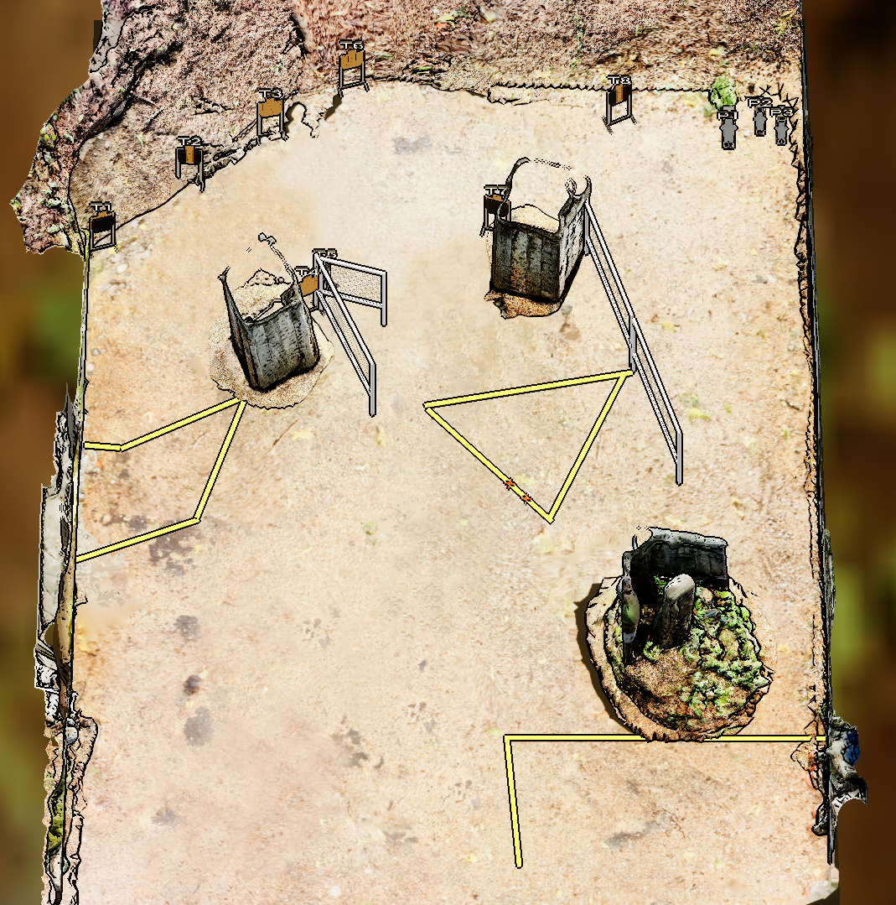
 | Stage 6 Me Frosted Flakes Course Designer: Eric Beerbaum & Marcel Englmaier

